Slide 1

Reflection
Common Uses
Accessing Information
The ClassLoader
Active Reflection

Slide 2

See Also
https://docs.oracle.com/javase/tutorial/reflect/
http://tutorials.jenkov.com/java-reflection/index.html
Notes:
Some additional information on concurrency

Slide 3
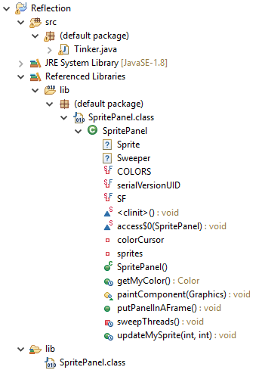
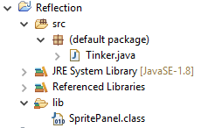

IDEs

Slide 4

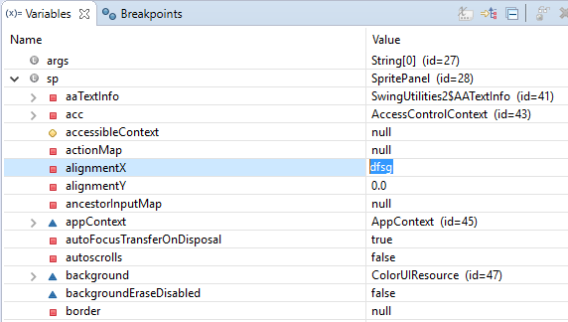
IDEs

Slide 5

Code Tools (JUnit)
public class MathFunctionsTest {
@AfterClass
public static void tearDown() {
System.out.println("After all tests");
}
@BeforeClass
public static void setup() {
System.out.println("Before all tests");
}
@Before
public void eachOne() {
System.out.println("Before each test");
}
}

Slide 6
Data Mappings (ORMs, etc.)
<Point>
<x>100</x>
<y>50</y>
</Point>
public Object readXML(String data) {
String name = ... // Read the name "Point" from the data
Map<String,String> atts = ... // Read "x=100" and "y=50"
// Create object of type in name
Object ret = createFromName(name);
// Set each attribute
for(String a : attributes.keySet()) {
setAttribute(ret, a, attributes.get(a));
}
return ret;
}
class Point {
private int x;
private int y;
Point() { ... }
public void setX(int x) { ... }
public void setY(int y) { ... }
}

Slide 7
Example Point
public class Point implements Serializable {
private static final long serialVersionUID = 1L;
private int x;
private int y;
public Point() { }
public Point(int x, int y) {
this.x = x;
this.y = y;
}
public void setX(int x) {this.x = x;}
public void setY(int y) {this.y = y;}
public int getX() {return x;}
public int getY() {return y;}
@Test
public void testPoint() {
System.out.println("Testing");
}
}
Interfaces
Private members
Constructors
Methods
Annotation

Slide 8
Getting the Class Object
public static void main(String[] args) {
Class c = Point.class;
Point p = new Point(1,2);
Class d = p.getClass();
Class<? extends Point> cc = Point.class;
Class<? extends Point> dd = p.getClass();
}
The JVM loads “.class” files into memory as needed. Each load creates a “Class” object with info from the “.class” file.
The “.getClass()” method is in the Object base class. It looks at the memory footprint and returns the exact Class object.

Slide 9
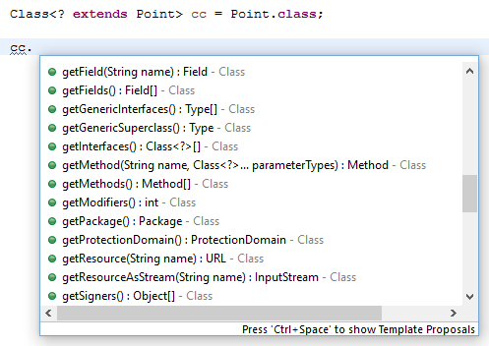
Methods of Class

Slide 10
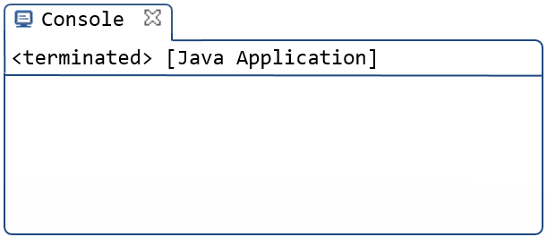
Name, Superclass, and Interfaces
Class<?> cc = Point.class;
String name = cc.getName();
System.out.println(name);
Class<?> base = cc.getSuperclass();
System.out.println(base);
Class<?>[] faces = cc.getInterfaces();
for(Class<?> face : faces) {
System.out.println(face);
}
Point
class java.lang.Object
interface java.io.Serializable
Notes:
getPackage

Slide 11
Fields
private static final
true
serialVersionUID
long
private
false
x
int
private
false
y
int
import java.lang.reflect.Field;
Class<?> cc = Point.class;
Field[] fields = cc.getDeclaredFields();
for(Field f : fields) {
int mod = f.getModifiers();
System.out.println(Modifier.toString(mod));
System.out.println(Modifier.isStatic(mod));
System.out.println(f.getName());
Class<?> ct = f.getType();
System.out.println(ct);
}

Slide 12
Using the Class
Class<?> tinkerClass = Tinker.class;
Class<?> cc = tinkerClass.getClassLoader().loadClass("Point");
Object ob = cc.newInstance();
Field fx = cc.getDeclaredField("x");
Field fy = cc.getDeclaredField("y");
fx.setAccessible(true);
fy.setAccessible(true);
fx.setInt(ob, 100);
fy.setInt(ob, 200);
System.out.println(ob.toString());
Exception in thread "main" java.lang.IllegalAccessException:
Class Tinker can not access a member of class Point with modifiers "private"
at sun.reflect.Reflection.ensureMemberAccess(Reflection.java:102)
at java.lang.reflect.AccessibleObject.slowCheckMemberAccess(AccessibleObject.java:296)
at java.lang.reflect.AccessibleObject.checkAccess(AccessibleObject.java:288)
at java.lang.reflect.Field.setInt(Field.java:946)
at Tinker.main(Tinker.java:24)
(100,200)

Slide 13
Constructors
Class<?> cc = Point.class;
Constructor<?>[] cons = cc.getConstructors();
for(Constructor<?> co : cons) {
System.out.println(co);
String name = co.getName();
int mod = co.getModifiers();
Class<?>[] params = co.getParameterTypes();
Class<?>[] excpts = co.getExceptionTypes();
}
Constructor<?> co = cc.getConstructor(int.class, int.class);
Object o = co.newInstance(10,20);
System.out.println(o.toString());
public Point()
public Point(int,int)
(10,20)

Slide 14
Methods
Class<?> cc = Point.class;
//Method[] ms = cc.getMethods();
Method[] ms = cc.getDeclaredMethods();
for(Method m : ms) {
System.out.println(m);
String name = m.getName();
int mod = m.getModifiers();
Class<?> r = m.getReturnType();
Parameter[] ps = m.getParameters();
for(Parameter param : ps) {
Class<?> pt = param.getType();
String nm = param.getName();
}
}
public java.lang.String Point.toString()
public void Point.setX(int)
public void Point.setY(int)
public int Point.getX()
public void Point.testPoint()
public int Point.getY()

Slide 15
Invoking Methods
Class<?> cc = Point.class;
Point p = new Point();
Method m = cc.getMethod("setX", int.class);
m.invoke(p, 123);
m = cc.getMethod("getX");
int v = (int) m.invoke(p);
System.out.println(v);
m = cc.getMethod("toString");
String g = (String) m.invoke(p);
System.out.println(g);
123
(123,0)

Slide 16
Finding the Tests
Class<?> cc = Point.class;
Point p = new Point();
// Annotations are classes too
Class<?> ts = org.junit.Test.class;
Method[] ms = cc.getDeclaredMethods();
for(Method m : ms) {
Annotation[] ans = m.getAnnotations();
boolean testIt = false;
for(Annotation a : ans) {
if(a.annotationType()==ts) { // ==
testIt = true;
}
}
if(testIt) {
System.out.println("Testing "+m.getName());
m.invoke(p);
}
}
Testing testPoint
Testing

Slide 17

Tinkering
Write a function to print the name of the public methods for any object passed in.
Try your function with objects from the library.
Create an array of ints using only reflection (you’ll have to dig deeper in the docs).

